Slide 1
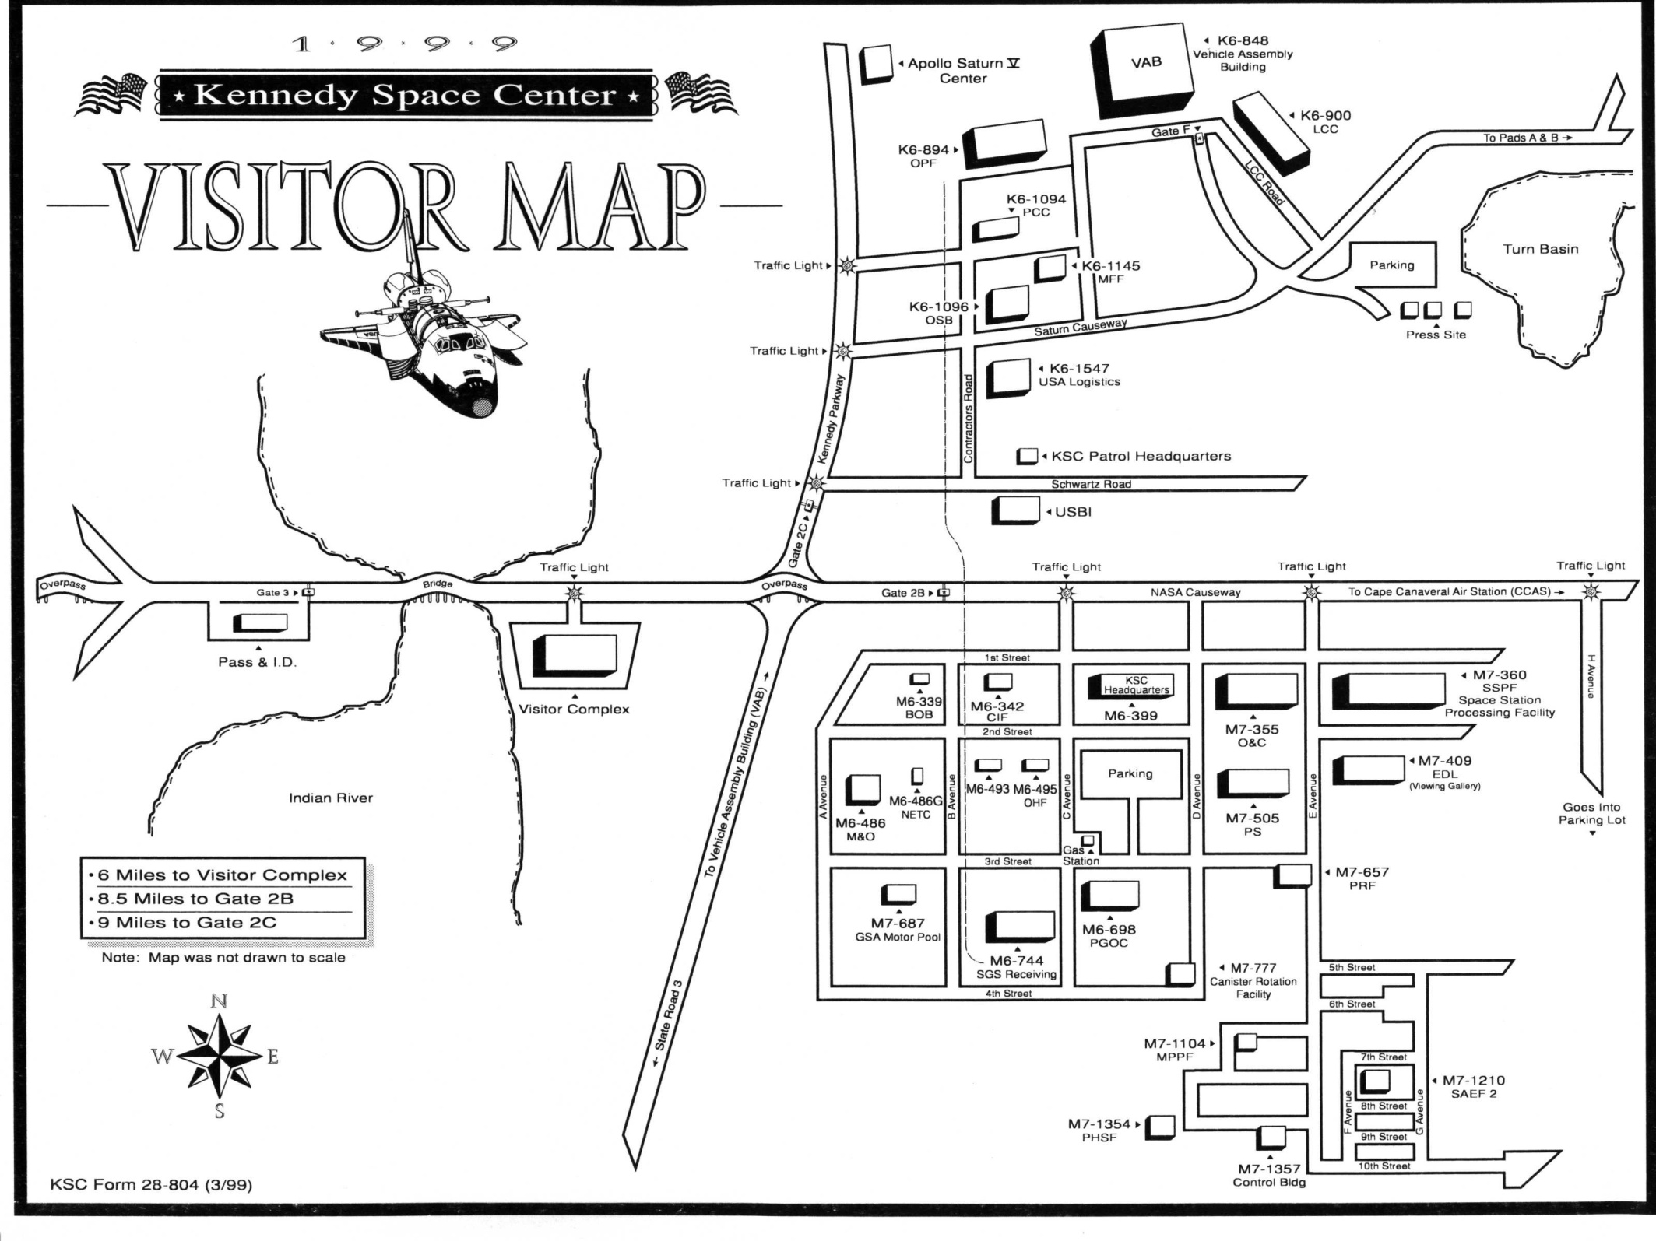
N
Traffic Light
OSB II R#5109
New Guard Gate
Pass & ID
Building

